Slide 1


INSA Security Audit Process
Day V

Slide 2
Objective
Understand the purpose and process of the INSA Security Audit.
Describe the three major phases of the audit.
Identify key security findings and the actions taken to resolve them.
Recognize the importance of secure development practices in maintaining compliance.

Slide 3
INSA Security Audit Overview & Process
Session - 1
Learning Objectives:
  Introduce the INSA Security Audit framework, its purpose, and how the DLC platform went through each phase.

Slide 4

What is INSA Security Audit?
Conducted by the Information Network Security Administration (INSA)
Aims to evaluate, test, and verify the security strength of digital systems
Ensures government digital systems meet national cybersecurity standards
Covers: infrastructure, application, data, and operational security

Slide 5
Audit Phases Overview
Three Phases of the INSA Security Audit Process
  Security Audit Document Preparation
  INSA Security Audit Report
  Response and Remediation Actions

Slide 6
Phase 1:
Security Audit Document Preparation
Before the system was audited, we prepared a detailed document describing the DLC system’s technical and security aspects.
Included Sections:
  Objective of the audit
  Application overview (features, actors, requirements)
  System architecture
  Security functionalities
  Secure coding standards

Slide 7
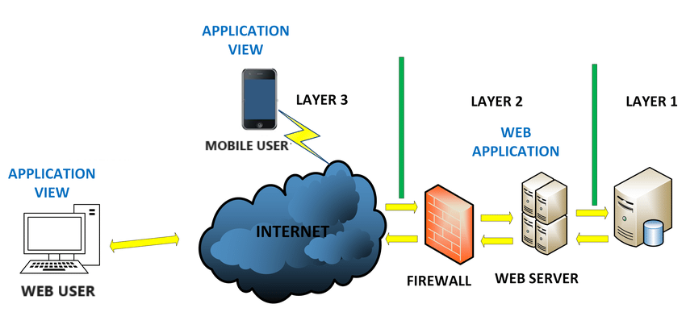
System Architecture
Architecture shows the overall system components, their interaction and level of integration.
  System hardware architecture

Slide 8
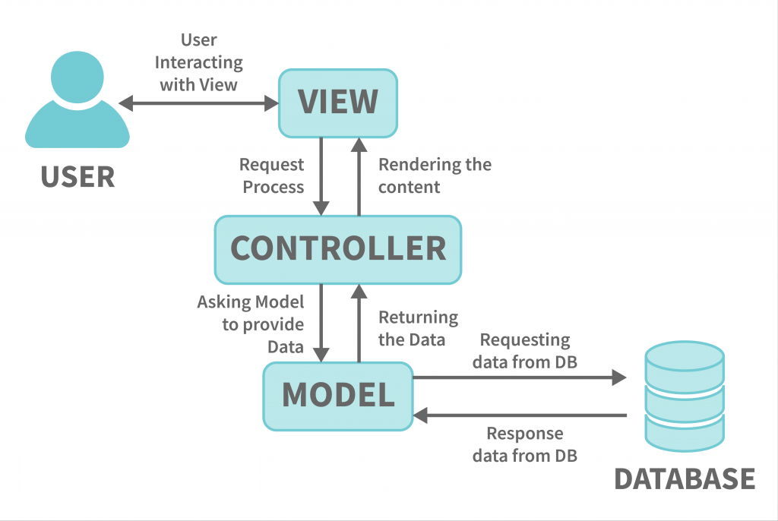
  Software Architecture

Slide 9
Security functionalities
Web Platform
  CSRF Protection (Cross-Site Request Forgery)
  Password Hashing (bcrypt)
  SQL Injection Protection
  XSS Protection (Cross-Site Scripting)
  Authentication System
  Authorization Policies & Gates
  Input Validation
  Mass Assignment Protection

Slide 10
Mobile Application
  HTTPS/TLS by Default (Fetch / Axios)
  Secure Storage APIs (Platform-based)
  Protection Against XSS
  Permissions Management
  Safe Mode for WebViews

Slide 11
Security Overview
Network & Infrastructure Security: Firewalls, HTTPS, server access
Application Security: CSRF tokens, SQL injection protection
Data Security & Privacy: Encryption, backup, restricted access
Authentication & Authorization: Role-based access control
Operational Security: Regular updates, monitoring, incident handling

Slide 12
Secure Coding Standards
Categories:
  General Principles: Input validation, output sanitization
  Mobile App Security: Network protection, secure data storage, auth logic
  Web Application Security: Encryption keys, CSRF tokens, password reset
  Authorization Controls: Role-based rules for access

Slide 13
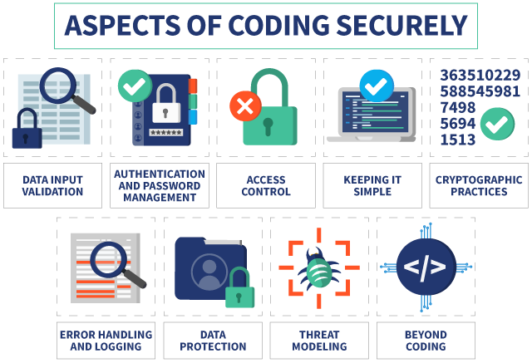

Slide 14
Phase 2:
INSA Audit Execution & Report
Overview
  INSA conducted Vulnerability Assessment & Penetration Testing
  Simulated real-world attacks using advanced tools and practices
  Measured the system’s overall security posture
Key Deliverables:
  Vulnerability Assessment Report
  Risk Level Classification
  Remediation Recommendations

Slide 15
Existing Security Controls Acknowledged:
  Enforced HTTPS redirection
    HTTPS redirection ensures that all users automatically access the system through a secure, encrypted connection.
  Secure cookie handling
    Secure cookie handling involves setting cookie flags such as Secure, HttpOnly, and SameSite to prevent unauthorized access.
  SQL Injection protection
    SQL Injection protection ensures that all user inputs are properly validated and sanitized before interacting with the database.

Slide 16
INSA Summary of Findings
Reported Vulnerabilities:
Issue | Risk Level
Unrestricted File Upload | High
Application Logic Error | Medium
No Account Lockout | Medium
Missing Security Headers | Medium
Poor Password Complexity | Medium
Improper Input Validation | Medium
Weak Session Expiration | Medium

Slide 17
Findings, Mitigation & Final Outcomes
Session - 2
Learning Objectives:
  Demonstrate how vulnerabilities were mitigated and lessons learned for maintaining security post-audit.

Slide 18
Phase 3:
Response and Remediation Actions
After receiving the audit report, the team analyzed every finding and applied corrective measures across code, configuration, and infrastructure.
  Goal: Achieve compliance and approval from INSA.

Slide 19
1. Unrestricted File Upload
Action Taken:
  Server-side file validation
  Automatic file renaming
  Restricted folder access (no script execution)
  Frontend file type validation
Result: No more malicious uploads possible.

Slide 20
2. Application Logic / Configuration Error
Action Taken:
  Updated .env for production mode
  Generic error pages
  Denied public access to configuration files
Result: Environment exposure eliminated.

Slide 21
3. Authentication & Authorization Fixes
No Account Lockout → Fixed by:
  Laravel rate limiting & lockout timer
  User feedback on failed attempts
Weak Password Policy → Fixed by:
  Enforcing complex password rules
  Applied across all forms

Slide 22
4: Header and Input Validation
Missing Security Headers →
  Added middleware-based header enforcement
Improper Input Validation →
  Introduced standardized validation rules
  Consistency across all forms
Weak Session Timeout →
  Reduced inactivity limit to 10 minutes
  Implemented session auto-logout middleware

Slide 23
Summary of Improvements
All vulnerabilities addressed through:
  Secure configuration
  Code updates
  Middleware enforcement
  User policy strengthening

Slide 24
Lessons Learned
Document every security configuration
Regular internal testing before audits
Adopt secure coding standards continuously
Maintain a feedback loop between developers & security team

Slide 25
Final Outcome
INSA confirmed all vulnerabilities were mitigated successfully
System approved for live deployment
Strengthened confidence in system reliability and security posture

Slide 26


